Slide 1
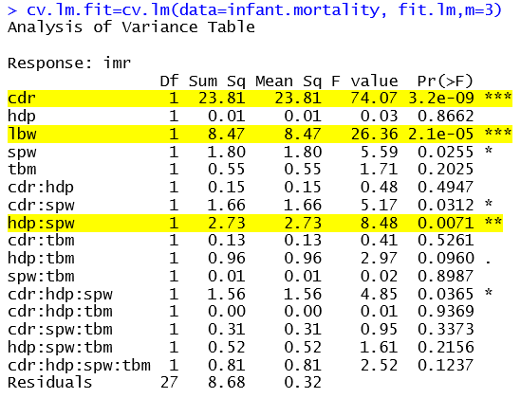
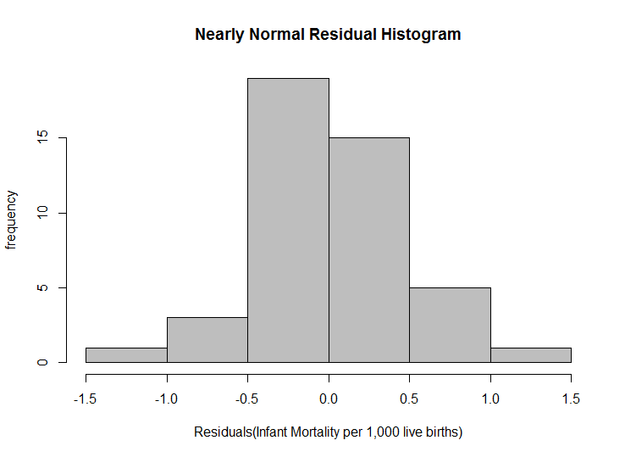
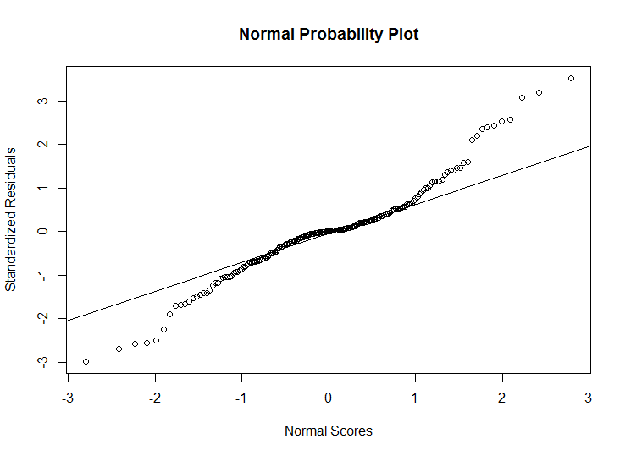

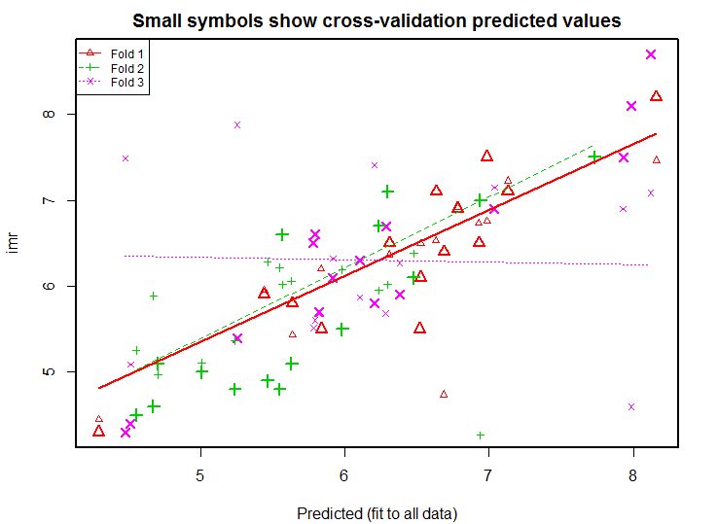
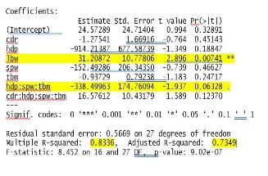
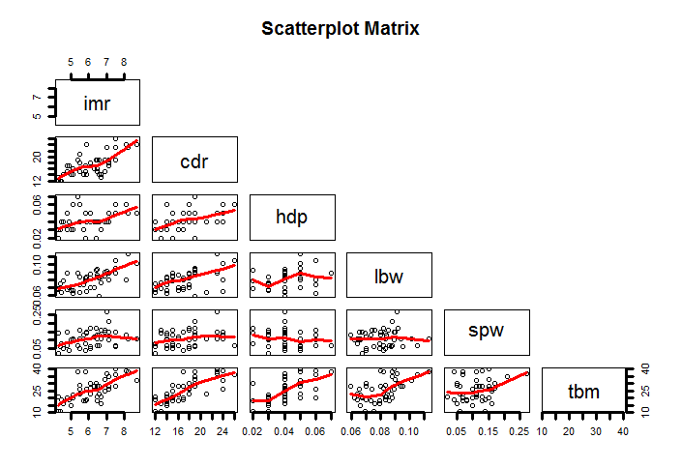
INFANT MORTALITY RATE
Multiple Regression
Introduction:
Infant mortality is reported as the rate of deaths of newborn per 1000 lives. The data used in this poster was recorded in 2014 for each of the 45 states of the united states. To predict infants mortality, we will build a regression model using this data.
Chosen Variables:
Low Birth Weight Babies percent < 5.5 pounds
Mothers who smoked during pregnancy in percent
Child death rate per 100,000 children
High School Drop Out in percent
Births to teenagers per 1,000 females
Infant Mortality Rate - Deaths occurring to infants under 1 year of age per 1,000 live births
Inference for Multiple Regression :
Null Hypothesis Rejected:
The model is no different than its
mean
Outliers – Removed:
Some states like South Dakota had
outliers
Straight Enough Conditions:
Nearly Normal Condition :
Residual Errors are nearly normal as depicted
by the two plots below.
3-fold Cross Validation – An Improvement:
Multiple Regression Model:
R-Squared Value shows 83% variability is explained by our model.
F-Statistic of 8.4 is large enough to reject null hypothesis.
Low p-value and high coefficient for “low birthweight” babies shows it contributes largely to our model.
Conclusion:
Apparently, the Standard Error for the coefficients of the parameters used is too high .However ,its clear that an increase in the number of low birth weight babies (lbw) 1 per 100 results into an increase of 31 deaths per 1000 live births in the infant mortality rate.
Notes:
References :
http://datacenter.kidscount.org/
www.stat.berkeley.edu/~brill/Stat131a/29_multi.pdf

